Slide 1

Classification of Facebook Newsfeeds and Sentiment Analysis

Slide 2
Agenda
Introduction
Problem Statement
Flow of our proposed classification system
Facebook Existing Features Versus Our Approach
Previous Work
Prospective
Proposed Work
Methodology
Results
Conclusion
References

Slide 3
Introduction
Recently seen in Google’s Gmail, the messages in inbox are classified which makes helps users to find important mails from irrelevant advertising messages.
Facebook is usually flooded with huge amount of data which makes it annoying for the users to view the important news feeds.

Slide 4
Problem Statement
To develop a system that classifies newsfeeds collected from facebook into liked pages’ posts and friends’ posts. Further, categorization of friends’ posts into life and entertainment categories, then performing sentiment analysis to detect the sentiments depicted by the life event posts.

Slide 5
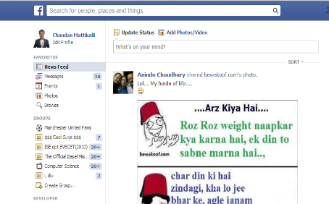





News Feed
Flow of our proposed classification system
Friends Posts
Classifier
Guys watch the trailer of this new movie
Post: Twinkle Twinkle Little star
Tag Classifier
Entertainment Posts
Life Event Posts
Post: Twinkle Twinkle Little star
Guys watch the trailer of this new movie
.
.
.
Liked Page Posts
.
.
.
Sentiment Analysis

Slide 6
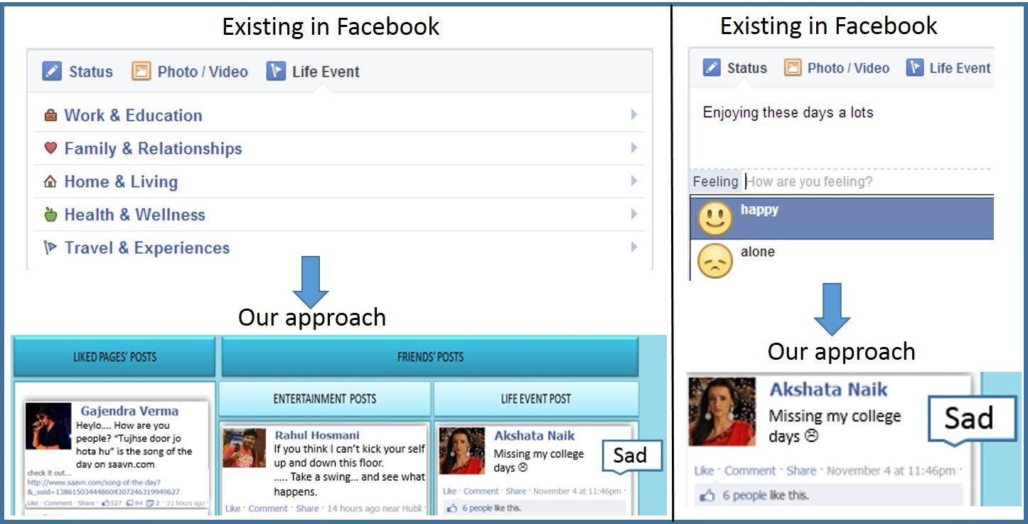
Facebook Existing Features Versus Our Approach

Slide 7
Previous Work
In paper “Opinion Extraction and Classification of Real Time Facebook
Status ” authors speaks about opinion mining on Facebook status which were split automatically into three sets as comments.
containing positive impact such as good, best, happy.
containing negative impact bad, worst, sorrow.
containing average impact neutral, average, fine.
The opinion of the user regarding only a specific topic was analyzed.
This feature of identifying the sentiments was inherited in our project to analyze the sentiment of the user automatically instead of user explicitly mentioning it.
Notes:
[2] This concept was extracted in our approach.

Slide 8
Previous Work
In the paper “Classifying business marketing messages on facebook” authors demonstrate that although the majority of company posts on facebook are aimed for direct sales and promotions, it is their communication messages that received the most attention from customers.
On these lines, in our approach we considered facebook live news feeds to be classified into life posts and entertainment posts.
According to the authors, Marketing messages account for 73% of all messages in facebook , but Communication messages received much more attention.
Similarly user’s wall is flooded with entertainment posts but life event posts are of greater importance to the user.
Hence classifying the posts, and allowing the users to see what they want to see, provides a better view to them.

Slide 9
Previous Work
In paper “Detection of news feeds items appropriate for children”, authors explores the classification problem for news feeds determining whether short snippets for individual feed entries are appropriate for children.
To classify feeds to be appropriate for children , information given by the title, link and snippet was used.
Similarly, we chose relevant fields like captions, message, link and description of the news feed to classify them.
Within standard news feeds there were over 50,000 unique terms, while for children's news feeds there were around 6,000 unique terms, i.e. these terms only occurred in the standard news feeds or children's news feeds respectively.
Similarly, some terms appeared only in life event posts and some only in entertainment posts . These terms were used for classification.

Slide 10
Previous Work
In paper “Sentiment analysis: Facebook status messages” authors’ focus is on classifying sentiment of Facebook status updates using binary and multi-class labels.
For binary classification, positive and negative sentiment labels were chosen for classification.
We try to adopt a similar idea to automatically categorize sentiments for facebook news feeds.

Slide 11
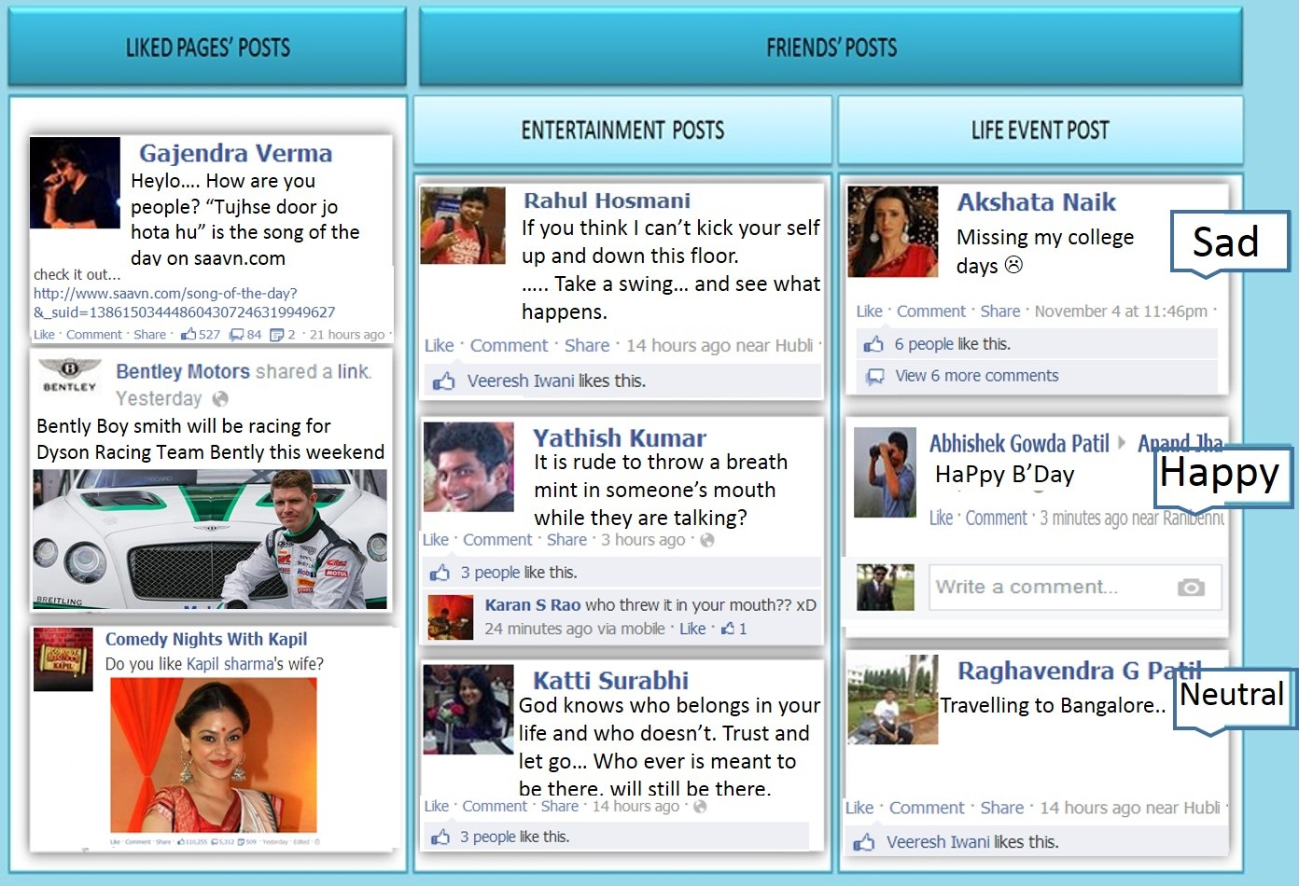
Prospective
Classified Facebook Data

Slide 12
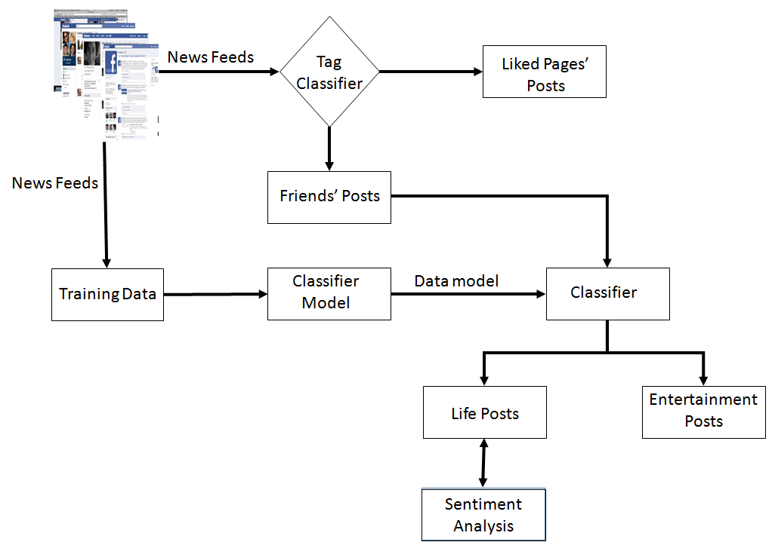
Proposed Work
Model showing classification and sentiment analysis of facebook news feeds

Slide 13
Methodology
Steps followed in our approach are broadly classified as :
Data extraction
Classification
Sentiment Analysis

Slide 14
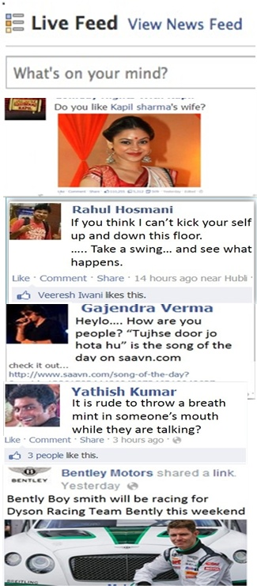





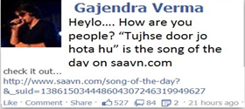


Data Extraction

Slide 15







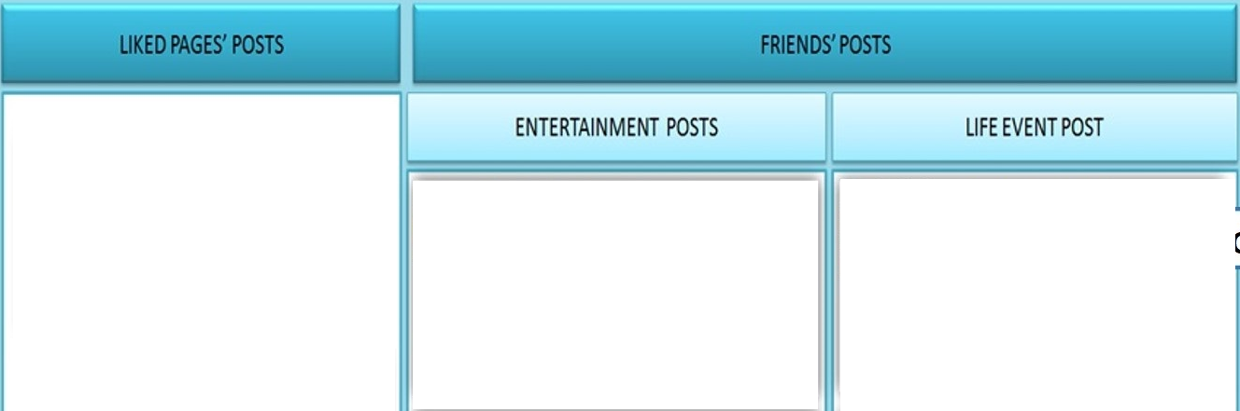



Classification
Classified as like pages’ post
Weka Classifier
Yes
Is Null?
No
Our Learning Model

Slide 16








Sentiment Analysis
SentiWordNet
Dictionary
Is –ve?

Slide 17
Results
Accuracy of Classification Algorithms
Algorithms | Accuracy
Bayes Net | 94.69%
J48 | 93.73%
Naïve Bayes | 92.70%
SVM | 94.75%
Logistic Regression | 92.71%

Slide 18
Results
Comparison of Accuracy using Weka and Learning Model-Training Data Set 1
No of posts | Weka’s SVM | SVM Learning Model | Weka’s Logistic Regression | Logistic Regression Learning Model
200 | 93.60% | 98.50% | 93.01% | 93.50%
400 | 93.69% | 98.50% | 92.70% | 91.50%
600 | 93.46% | 97.66% | 91.10% | 86.50%
800 | 93.51% | 97.75% | 91.93% | 85.60%
1000 | 93.47% | 97.13% | 91.31% | 83.85%

Slide 19
Results
Comparison of Accuracy using Weka and Learning Model-Training Data Set 2
No of posts | Weka’s SVM | SVM Learning Model | Weka’s Logistic Regression | Logistic Regression Learning Model
200 | 93.44% | 98.50% | 89.94% | 71.50%
400 | 93.22% | 97.75% | 91.97% | 73.50%
600 | 93.00% | 97.16% | 90.98% | 68.83%
800 | 92..96% | 96.50% | 92.99% | 70.35%
1000 | 92.96% | 96.10% | 92.49% | 73.40%

Slide 20
Results
Comparison of Accuracy using Weka and Learning Model-Training Data Set 3
No of posts | Weka’s SVM | SVM Learning Model | Weka’s Logistic Regression | Logistic Regression Learning Model
200 | 92.84% | 97.48% | 92.49% | 64.82%
400 | 92.97% | 96.49% | 95.00% | 60.65%
600 | 92.85% | 96.82% | 91.78% | 62.93%
800 | 93.37% | 96.37% | 91.48% | 64.20%
1000 | 93.68% | 96.60% | 92.24% | 63.80%

Slide 21
Conclusion
We developed a model to classify posts appearing on users Facebook wall to find most important news feeds and to automatically detect the sentiments of the user.
Experiments on the live news feeds showed that the proposed approach could achieve significantly improved performance for structuring the data on Facebook using SVM classifier learning model.
B. V. Bhoomaraddi College of Engineering and Technology, Hubli-India

Slide 22
References
[1] Facebook developers. [Online]. Available:
https://developers.facebook.com/
[2] Google inbox categories. [Online]. Available:
https://support.google.com/mail/answer/3094596?hl=en
[3] Emarketer. [Online]. Available:
http://www.emarketer.com/Article/Social-Networking-Reaches-Nearly-
One-Four-Around-World/1009976
[4] A. Shrivatava and B. Pant, “Opinion extraction and classification of
realtime facebook status,” Global Journal of Computer Science and
Technology, vol. 12, pp. 35–40, 2012.

Slide 23
References
[5] B. Yu and L. Kwok, “Classifying business marketing messages on
facebook,” in Proceedings of the SIGIR 2011 Workshop on Internet
Advertisement, 2011.
[6] T. Polajnar, R. Glassey, and L. Azzopardi, “Detection of news feeds
items appropriate for children.” in ECIR, ser. Lecture Notes in Computer
Science. Springer, 2012.
[7] J. K. Ahkter and S. Soria, “Sentiment analysis: Facebook status
messages,” The Stanford NLP Group, Stanford University, Natural
Language Processing, Final Project Report, 2010.

Slide 24
References
[8] Y. Cheng, K. Zhang, Y. Xie, A. Agrawal, W. keng Liao, and A. N.
Choudhary, “Learning to group web text incorporating prior information.”
in ICDM Workshops. IEEE, 2011, pp. 212–219.
[9] K. M. A. Chai, H. L. Chieu, and H. T. Ng, “Bayesian online classifiers
for text classification and filtering,” in Proceedings of the 25th Annual
International ACM SIGIR Conference on Research and Development in
Information Retrieval, ser. SIGIR ’02. ACM, 2002, pp. 97–104.
[10] C. J. C. Burges, “A tutorial on support vector machines for pattern
recognition,” Data Min. Knowl. Discov., vol. 2, no. 2, pp. 121–167,
Jun. 1998. Computer Science and Applications, pp. 256–261, 2013.

Slide 25
References
[11] N. Friedman and M. Goldszmidt, “Learning bayesian networks with
local structure.” in Uncertainty in Artificial Intelligence (UAI). Morgan
Kaufmann, 1996, pp. 252–262.
[12] R. P. Tina and S. S. Sherekar, “Performance analysis of nave bayes
and j48 classification algorithm for data classification,” Inter. Jour. of
[13] Sentiwordnet. [Online]. Available: http://sentiwordnet.isti.cnr.it/
[14] Restfb. [Online]. Available: http://restfb.com/

Slide 26
References
[15] Weka 3: Data mining software in java. [Online]. Available:
http://www.cs.waikato.ac.nz/ml/weka/
[16] Arff. [Online]. Available: http://www.cs.waikato.ac.nz/ml/weka/arff.html
[17] R. Kohavi, “A study of cross-validation and bootstrap for accuracy estimation
and model selection,” in Proceedings of the 14th International
Joint Conference on Artificial Intelligence - Volume 2, ser. IJCAI’95.
Morgan Kaufmann Publishers Inc., 1995, pp. 1137–1143.

Slide 27
THANK YOU !

